Slide 1
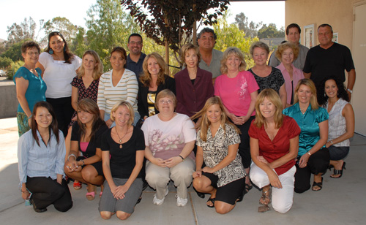
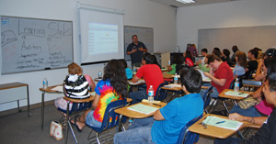
Conversations about Student Success...
Part IV
Cuyamaca College’s Personal Development Counseling (PDC) Programs
www.cuyamaca.edu/pdc

Slide 2
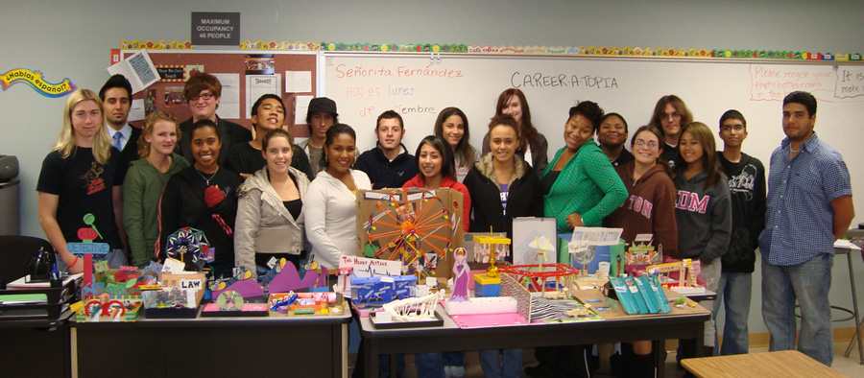
What is Personal Development Counseling (PDC)?
Academic Counseling Study Skills Educational Planning Goal Setting Decision Making Time Management
Career Counseling
Choosing a major
Career Exploration Personality Assessment
Vocational Assessment
Workforce Professional Development (soft skills)
Personal/Social Counseling
Motivation
Persistence
Communication

Slide 3
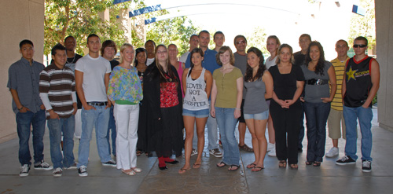
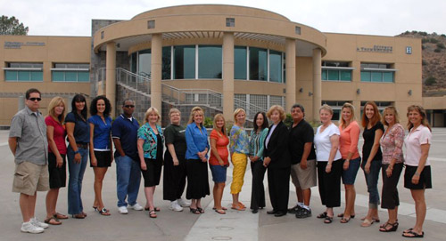
PDC Programs
Basic Skills programs
Learning Communities (linked with Math and English) First Year Success Program Comprehensive Orientation and Assessment
Orientation for Arabic Speaking CalWORKS recipients
“PDC for HS” programs
Outreach programs offered on every campus in GUHSD
New “College for Me” at Helix Charter Online classes for “Juvenile Court School” youth
Campus programs
Online Blended
“Traditional” PDSS courses – students with disabilities
Notes:
3

Slide 4
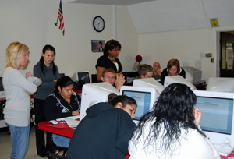
Fall 2008 Top Subjects
Top Subjects by Enrollment

Slide 5
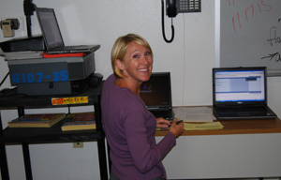
Fall 2008 PDC/PDSS Cohort
This study includes all Fall 2008 PDC and PDSS students at Cuyamaca College…
There were 9,351 students in Fall 2008, and 1,090 (11.7%) of those students took PDC and/or PDSS.

Slide 6
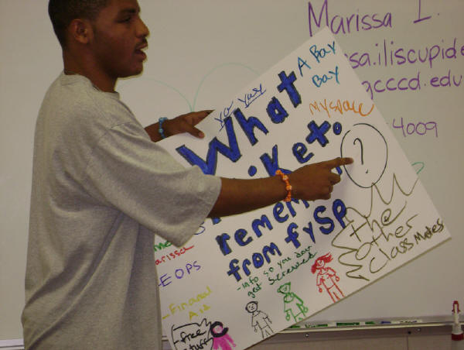
Fall 2008 PDC/PDSS Cohort
Student Ethnicity (Percent)

Slide 7
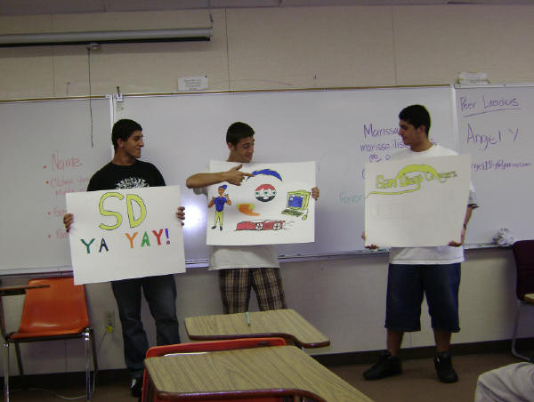
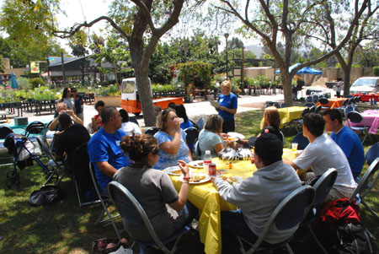
Fall 2008 PDC/PDSS Cohort
Student Age (Percent)

Slide 8
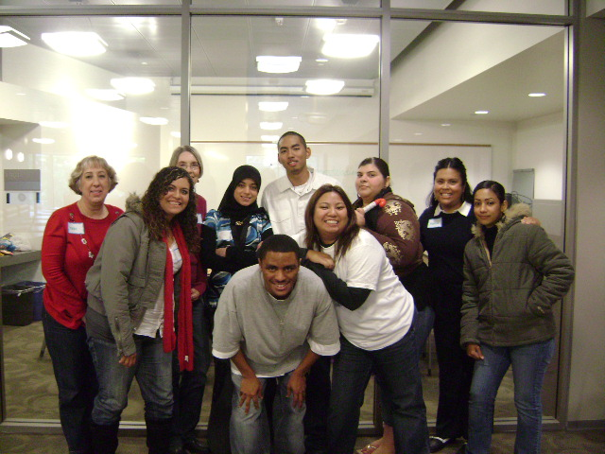
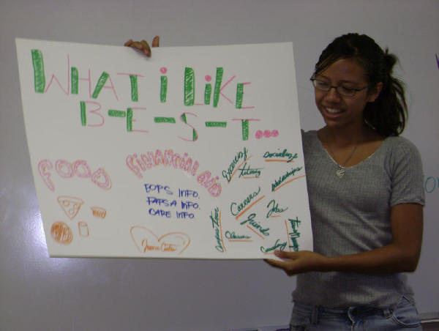
Fall 2008 PDC/PDSS Cohort
Basic Skills Students
Percent
Percent of PDC students assessed into or concurrently taking a Basic Skills English, ESL and/or Math course.

Slide 9
Success Rate of Students Enrolled in Math 088 (Prealgebra) linked with PDC 130
All Students
Underrepresented Students
 | Learning community | Non-learning community
Semester | Percent | Percent
Fall 2008 | 60.0% | 50.0%
Spring 2009 | 68.6% | 60.3%
Combined semesters | 64.6% | 54.7%
 | Learning community | Non-learning community
Semester | Percent | Percent
Fall 2008 | 38.5% | 43.2%
Spring 2009 | 63.2% | 45.5%
Combined semesters | 53.1% | 44.2%

Slide 10
Persistence Rate of Students Enrolled in Math 088 (Prealgebra) linked with PDC 130
All Students
Underrepresented Students
 | Learning community | Non-learning community
Semester | Percent | Percent
Fall 2008 | 83.3% | 59.6%
Spring 2009 | 54.2% | 40.4%
Combined semesters | 66.7% | 50.0%
 |  | Learning community | Non-learning community
Semester | Re-coded Ethnicity | Percent | Percent
Fall 2008 | Underrepresented | 80.0% | 73.7%
 | Not underrepresented | 81.8% | 44.0%
Spring 2009 | Underrepresented | 58.3% | 26.7%
 | Not underrepresented | 75.0% | 40.0%
Combined semesters | Underrepresented | 64.7% | 52.9%
 | Not underrepresented | 78.9% | 42.2%

Slide 11
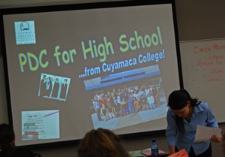
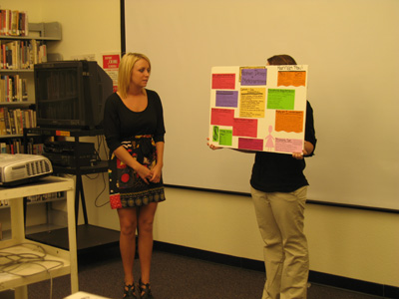
Fall 2008: Who Passed?
“What were students’ success rates in PDC/PDSS?”

Slide 12
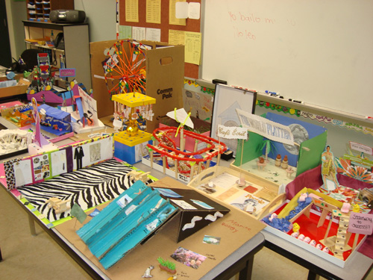
Fall 2008: Who Stayed?
“Did students persist to Spring 2009*?”
Percent
* Percent of Fall 2008 students who persisted to Spring 2009. Persistence is unduplicated within course type. Students taking more than one type of PDC course are represented once for each type.

Slide 13
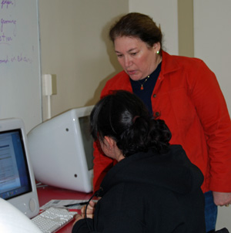
Fall 2008: Who Stayed?
“Did successful students persist to Spring 2009*?”
Percent
* Percent of Fall 2008 students successful in PDC/PDSS who persisted to Spring 2009. Persistence is unduplicated within course type. Students taking more than one type of PDC course are represented once for each type.

Slide 14
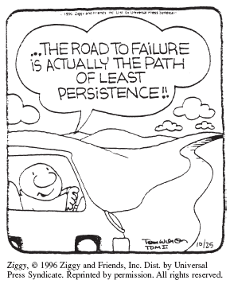
Fall 2008: Who Stayed?
“Did students persist to Fall 2009*?”
Percent
* Percent of Fall 2008 students who persisted to Fall 2009. Persistence is unduplicated within course type. Students taking more than one type of PDC course are represented once for each type.

Slide 15
Fall 2008: Who Stayed?
“Did successful students persist to Fall 2009*?”
Percent
* Percent of Fall 2008 students successful in PDC/PDSS who persisted to Fall 2009. Persistence is unduplicated within course type. Students taking more than one type of PDC course are represented once for each type.

Slide 16
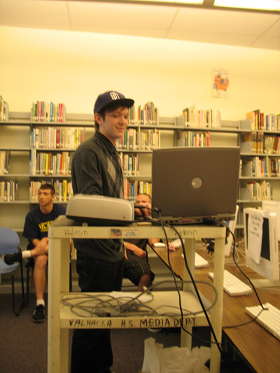
GCCCD Fall 2002: What next?
Graduation Rates*
Percent
* Percent of Fall 2002 first-time GCCCD students with a goal of degree/certificate/transfer who earned a degree or certificate within 6 years.

Slide 17
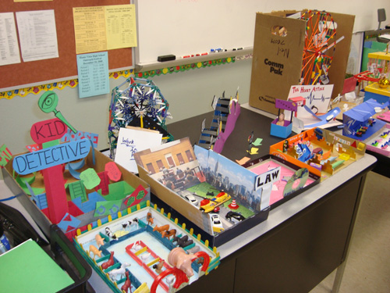
GCCCD Fall 2002: What next?
Transfer Rates*
Percent
* Percent of Fall 2002 GCCCD first-time students with a goal of degree/certificate/transfer who transferred within 6 years.

Slide 18
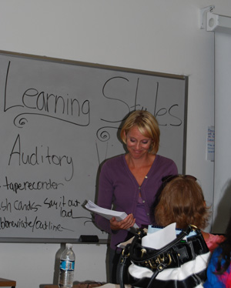
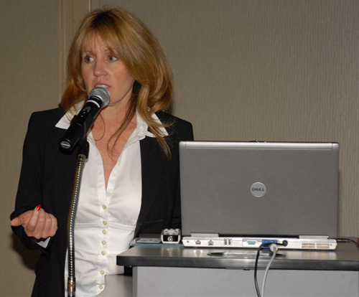
Fall 2009 Survey: How helpful was PDC with choosing/confirming a major/career?*
Percent
* Percentage of respondents indicating helpful, very helpful, or extremely helpful on a 5-point Likert scale ranging from not helpful to extremely helpful.
Notes:
18

Slide 19
Fall 2009 Survey: How helpful was PDC with improving your chances for success in college?
Percent
* Percentage of respondents indicating helpful, very helpful, or extremely helpful on a 5-point Likert scale ranging from not helpful to extremely helpful.
Notes:
19

Slide 20
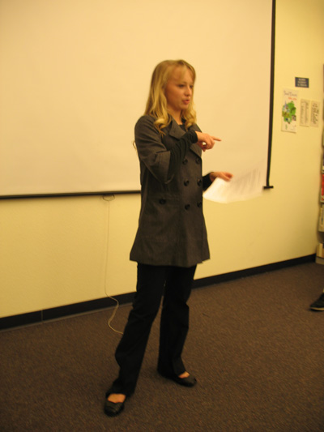
Fall 2009 Survey: How helpful was PDC with improving your chances for success in your future career?
Percent
* Percentage of respondents indicating helpful, very helpful, or extremely helpful on a 5-point Likert scale ranging from not helpful to extremely helpful.
Notes:
20

Slide 21
What do the Students and Faculty say?
Faculty Snapshot
Thank You! GCCCD Board
Dr. Chancellor Miles Jerry Buckley Sarah Donnelly
Ron Manzoni
Dr. Tim O’hare
PDC Students PDC Faculty
“Require PDC!”
www.cuyamaca.edu/pdc

