Slide 1
California Leadership Alliance for Student Success
CLASS
D I S C U S S I O N S
What Happens to our Basic Skills Students? February 2010

Slide 2
Discussions about Student Success Today’s Agenda:
Part I – Review our cohort – What have we learned so far?
Part II – What happens to our basic skills students?
Part III – Reviewing “Project Success”
Part IV - Reviewing Personal Development Counseling
Part V – What’s working?

Slide 3
Part I
Reviewing our Cohort Data

Slide 4
Reviewing the CLASS Initiative What have we learned?
Who remembers the numbers of degrees and certificates granted in 2006 -2007?
What is our overall retention rate?
What is our overall rate of student success?
How many students make up our CLASS study cohort?
How did they do their first semester?
What did their assessment and placement data look like?

Slide 5
A Snapshot of our Students
How many degrees & certificates?
2006-2007 Academic Year:
682 certificates
1,171 degrees
1,853 Total degrees & Certificates
61% female
39% male

Slide 6
A Snapshot of our Students
Overall Success of All Students
Fall 2006:
Course enrollments 84,781
Overall retention 79%
Overall success 65%

Slide 7
The Fall 2006 Cohort
This study includes all first-time college students…

Slide 8
Who Passed?
“How did all cohort students do in their first term?”
Each semester the colleges lose over 40% of their first time students…

Slide 9
Who Passed?
“How did all cohort students do in their first term?”

Slide 10
Fall 2006 “The Beginning”
Assessing our students skills…
3,300 students participated in assessment
36% were college ready
64% at pre-collegiate skill level

Slide 11
Fall 2006 “The Beginning”
What basic skills classes were taken?
Pre-collegiate students:
63% took at least one recommended course
37% took no recommended courses

Slide 12
Part II
What Happens to our Basic Skills Students?

Slide 13
Audience Participation Time…
What would you expect to see from our students regarding:
Assessment into Math & English courses?
Success rates in these pre-collegiate classes?
Achievement in later courses compared to students who do not take pre-collegiate courses?

Slide 14
Fall 2006 Cohort Student Assessment Data
3,300 students were assessed district-wide for Fall 2006

Slide 15
Fall 2006 Cohort Pre-Collegiate English
1,808 students assessed into pre-collegiate English

Slide 16
Subsequent Term Success Rates Spring 2007 – Spring 2009
Outcomes by Percentage
17,449 district-wide enrollments

Slide 17
Fall 2006 Cohort Pre-Collegiate Math
849 students assessed into pre-collegiate Math

Slide 18
Subsequent Term Success Rates Spring 2007 – Spring 2009
Outcomes by Percentage
7,034 district-wide enrollments

Slide 19
What Courses do Students Take?
Pre-Collegiate Students
Not Pre-Collegiate Students

Slide 20
Fall 2006 - Top Ten Courses taken by Pre-Collegiate Students
Course | % Students
English 098 – English Fundamentals | 16.4
Math 090 – Elementary Algebra | 7.2
English 098R – Reading Fundamentals | 5.2
English 090 – Basic English Skills | 3.0
Math 103 – Intermediate Algebra | 2.9
English 090R – Reading Skills Development | 2.5
Math 088 – Pre-Algebra | 1.6
* Math 110- Intermediate Algebra for Bus/Math/Science | 3.3
* PDC 124 – Lifelong Success | 2.1
* Psychology 120 – Introductory Psychology | 2.1
* CD 125 – Child Growth & Development | 1.2
* HED 120 – Personal Health & Lifestyles | 1.2

Slide 21
Success Rates for Pre-Collegiate Students in Degree or Transfer Courses

Slide 22
Fall 2006 - Top Ten Courses taken by “Not Pre-Collegiate Students”
Course | % Students
English 110 – English Composition | 6.3
Psychology 120 – Introductory Psychology | 3.2
Math 110 – Intermediate Algebra for Bus/Math/Science | 2.3
Math 103 – Intermediate Algebra | 2.2
English 120 – College Composition & Reading | 2.2
CD 125 – Child Growth & Development | 1.7
SOC 120 – Introductory Sociology | 1.5
PDC 124 – Lifelong Success | 1.4
SPAN 120 – Spanish I | 1.4
HED 120 – Personal Health & Lifestyles | 1.3
COMM 120 – Interpersonal Communication | 1.2
COMM 122 – Public Speaking | 1.2

Slide 23
Pre-Collegiate Students
What are we doing to help students have a better chance at success?...

Slide 24
Part III
Reviewing Project Success

Slide 25
Fall 2006: Who Passed?
“What were students’ success rates in English 98?”

Slide 26
Fall 2006: Who Stayed?
“Did students persist to Spring 2007*?”
* Percent of all Fall 2006 English 98 students who persisted to Spring 2007.

Slide 27
Fall 2006: Who Stayed?
“Did students persist to Fall 2007*?”
* Percent of all Fall 2006 English 98 students who persisted to Fall 2007.

Slide 28
Fall 2006: What next?
“Did students continue to English 120*?”
* Percent of students who were successful in English 98 in Fall 2006 and attempted English 120 by Fall 2007.

Slide 29
Fall 2006: Who graduated?
“Did students earn a degree or certificate*?”
* Percent of students with a goal of degree or certificate who graduated within 3 years (by Summer 2009).

Slide 30
Part IV
Reviewing Personal Development Counseling…

Slide 31
Fall 2008 PDC/PDSS Cohort
This study includes all Fall 2008 PDC and PDSS students at Cuyamaca College…
There were 9,351 students in Fall 2008, and 1,090 (11.7%) of those students took PDC and/or PDSS.

Slide 32
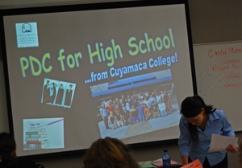
Fall 2008: Who Passed?
“What were students’ success rates in PDC/PDSS?”

Slide 33
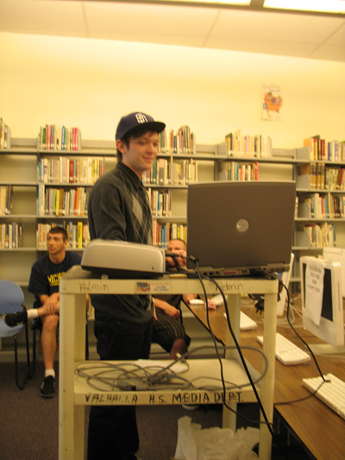
GCCCD Fall 2002:
Graduation Rates*
Percent
* Percent of Fall 2002 first-time GCCCD students with a goal of degree/certificate/transfer who earned a degree or certificate within 6 years.

Slide 34
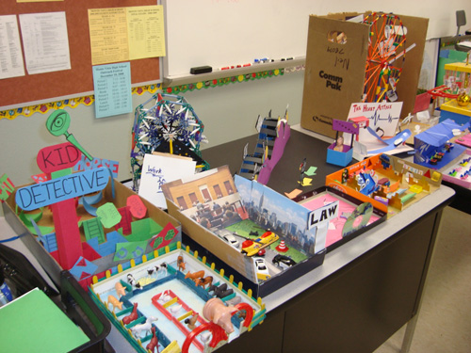
GCCCD Fall 2002:
Transfer Rates*
Percent
* Percent of Fall 2002 GCCCD first-time students with a goal of degree/certificate/transfer who transferred within 6 years.

Slide 35
Fall 2008 Top Subjects
Top Subjects by Enrollment

Slide 36
Part V
What’s working?

Slide 37
Promoting Student Success
Assessment and placement
Personal development counseling & courses
First-year college experience programs
Linked courses and course content
What else have you observed today?

Slide 39
Subsequent Term Success Rates (%) Spring 2007 – Spring 2009
Students Successful in Fall 2006 Pre-Collegiate English
4,053 Male and 5,532 Female district-wide enrollments

Slide 40
Subsequent Term Success Rates (%) Spring 2007 – Spring 2009
Unsuccessful / Withdrew from Fall 2006 Pre-Collegiate English
1,035 Male and 1,083 Female district-wide enrollments

Slide 41
Subsequent Term Success Rates (%) Spring 2007 – Spring 2009
Students who did not take English in Fall 2006
2,727 Male and 2,850 Female district-wide enrollments

Slide 42
Subsequent Term Success Rates (%) Spring 2007 – Spring 2009
Students Successful in Fall 2006 Pre-Collegiate Math
798 Male and 1,403 Female district-wide enrollments

Slide 43
Subsequent Term Success Rates (%) Spring 2007 – Spring 2009
Unsuccessful / Withdrew from Fall 2006 Pre-Collegiate Math
640 Male and 1158 Female district-wide enrollments

Slide 44
Subsequent Term Success Rates (%) Spring 2007 – Spring 2009
Students who did not take Math in Fall 2006
977 Male and 1,981 Female district-wide enrollments

