Slide 1
Conversations about Student Success… Part III Grossmont College’s “Project Success”

Slide 2
When Every Student Counts, Every Student Succeeds
Project Success: A Continuing Saga

Slide 3
Starring:
A Cast of Thousands

Slide 4
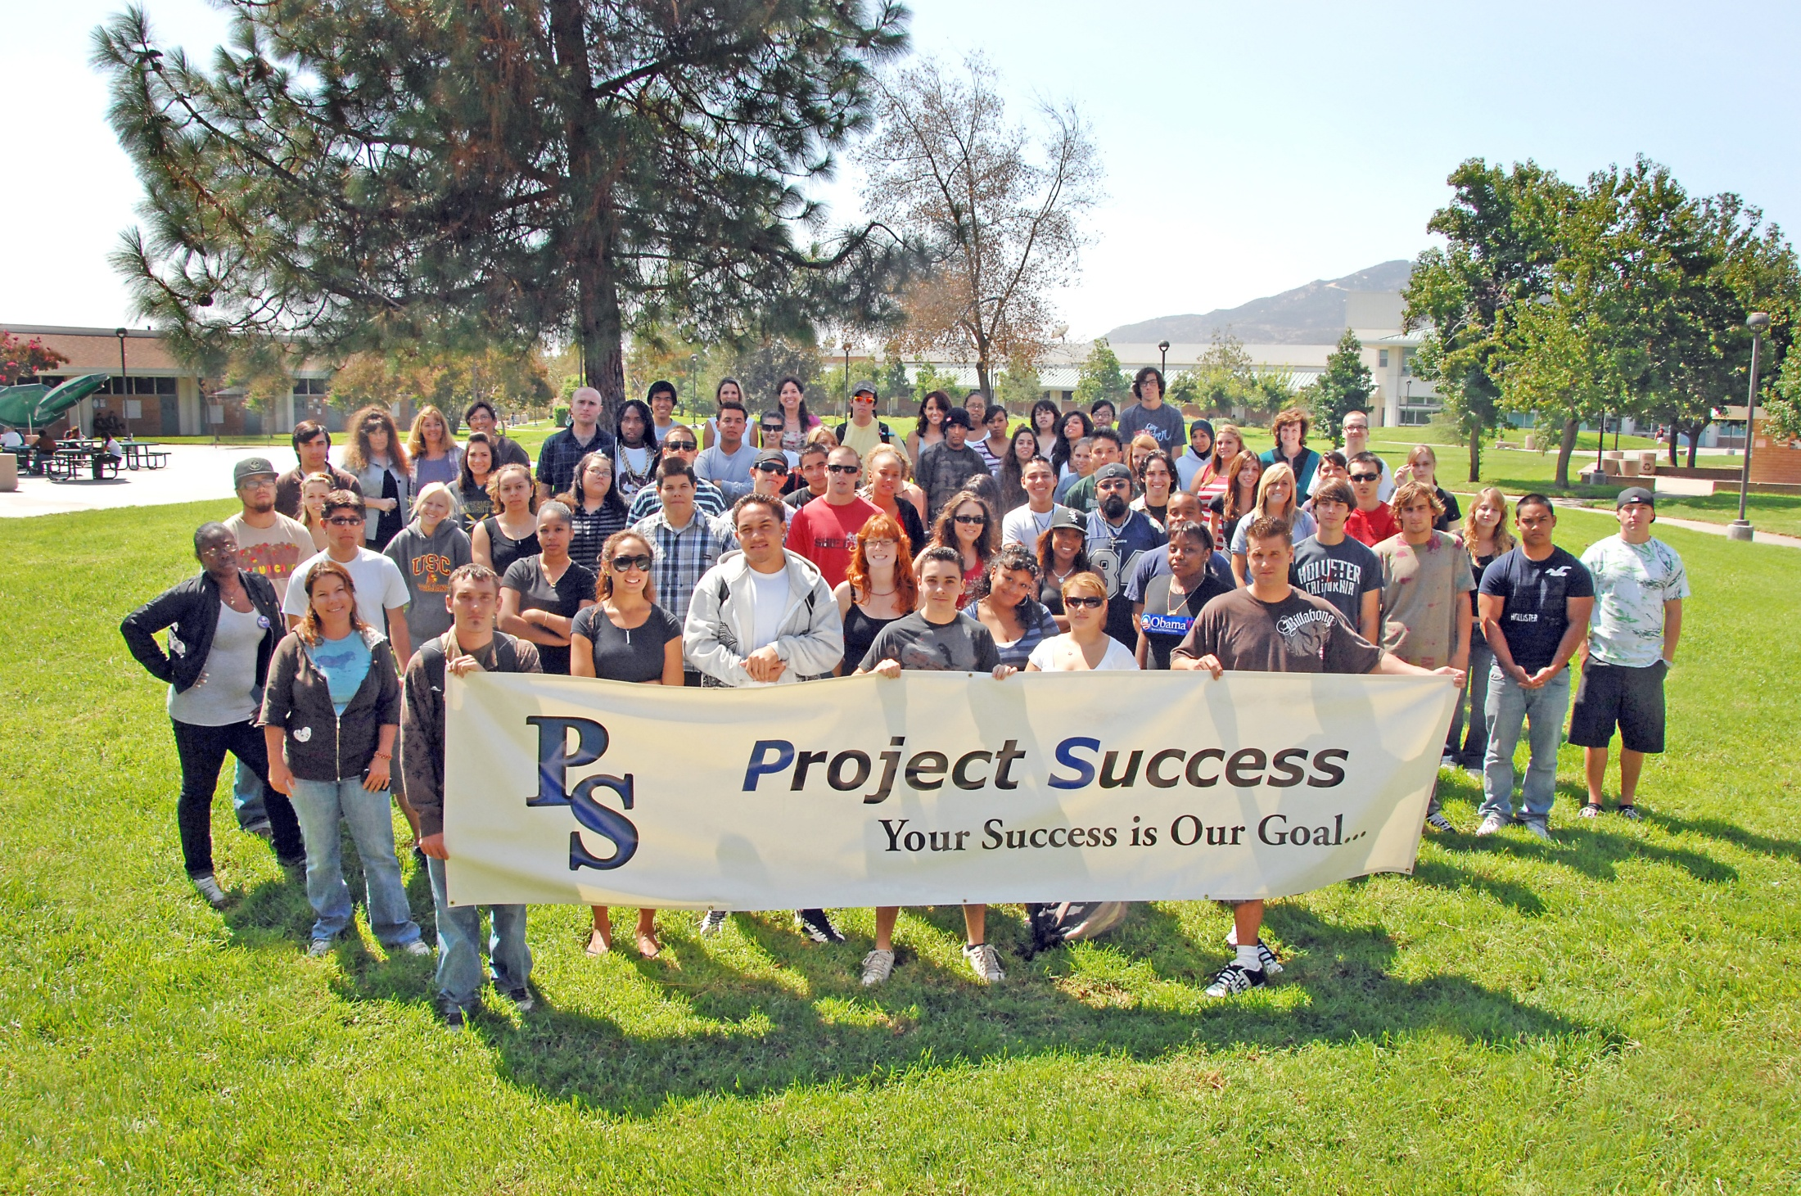
Starring:
A Cast of Thousands

Slide 5
Chapter 1
A Warrior’s Vision

Slide 7
Concurrent Reading and Writing Instruction
Is more effective in improving reading comprehension
Is more effective in improving vocabulary
Is more effective for academically underprepared students

Slide 8
One Developmental Link 1985
Grammar and Mechanics
Writing
Fiction and Non-Fiction Readings
Comprehension
Vocabulary Development
Safety and Security

Slide 9
Preliminary Research
1991-1994 Success Rates
Control Group(9,000)--Project Success(819)
58.9%---------68.6%

Slide 10
Chapter 2
The Vision Becomes Reality

Slide 11
Growth Years
From 1995 to the Present: Links include General Education Courses in Communication, Humanities, History, Science, Math, Geology, Anthropology, Philosophy, Psychology, and Literature
English 90 is linked to English 90R and Personal Development Courses

Slide 12
Fall 2006
12 Links of English 98/98R
Approximately 15 Instructors and 350 Students
Highly Coordinated Integration of Courses as a Result of Instructor Workshops (Curriculum Development-Sharing Teaching and Learning Strategies/Research)
Integrative Assignments and “Big Ideas”
Evaluating Our Work

Slide 13
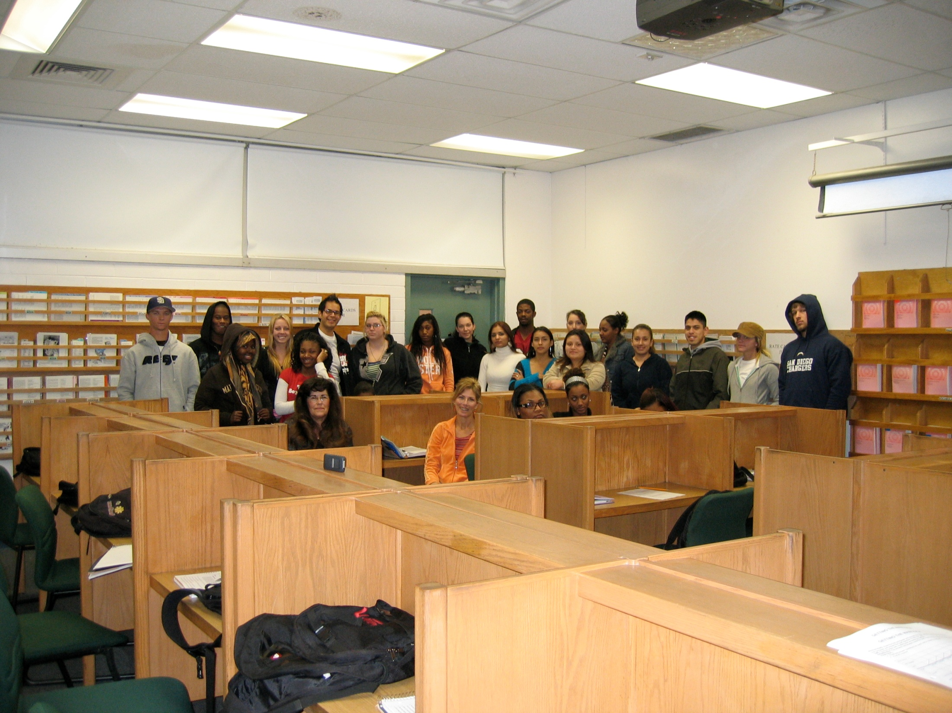
Chapter 2
The Vision Becomes Reality

Slide 14
Creating Community
Mentoring Instructors
Visiting Partner’s Classroom
Conferencing with Students
Building Partnerships with Counseling, Admissions, and Scheduling
Solving Problems with the Guidance of Administration

Slide 16
Fall 2006 Project Success Cohort
This study includes all Fall 2006 English 98 students at Grossmont College…

Slide 17
Fall 2006 Project Success Cohort
Gender
Percent

Slide 18
Fall 2006 Project Success Cohort
Student Ethnicity: (Percent)

Slide 19
Fall 2006 Project Success Cohort
Student Age: (Percent)

Slide 20
Fall 2006: Who Passed?
“What were students’ success rates in English 98?”

Slide 21
Fall 2006: Who Stayed?
“Did students persist to Spring 2007*?”
* Percent of all Fall 2006 English 98 students who persisted to Spring 2007.

Slide 22
Fall 2006: Who Stayed?
“Did students persist to Fall 2007*?”
* Percent of all Fall 2006 English 98 students who persisted to Fall 2007.

Slide 23
Fall 2006: What next?
“Did students continue to the next English course*?”
* Percent of students who were successful in English 98 in Fall 2006 and attempted English 110 by Spring 2007.

Slide 24
Fall 2006: What next?
“Did students continue to English 120*?”
* Percent of students who were successful in English 98 in Fall 2006 and attempted English 120 by Fall 2007.

Slide 25
Fall 2006: Who graduated?
“Did students earn a degree or certificate*?”
* Percent of students with a goal of degree or certificate who graduated within 3 years (by Summer 2009).

Slide 26
Chapter 3
Expanding Our Horizons…

Slide 27
Fall 2008
15 Links of English 98/98R
Approximately 15 Instructors and 400 Students
Developing Contextualized Links to Prepare Students for Career Pathways
Creating “The English Academy”

Slide 28
Fall 2008 Project Success Cohort
This study includes all Fall 2008 English 98 students at Grossmont College…

Slide 29
Fall 2008 Project Success Cohort
Gender
Percent

Slide 30
Fall 2008 Project Success Cohort
Student Ethnicity: (Percent)

Slide 31
Fall 2008 Project Success Cohort
Student Age: (Percent)

Slide 32
Fall 2008: Who Passed?
“What were students’ success rates in English 98?”

Slide 33
Fall 2008: Who Stayed?
“Did students persist to Spring 2009*?”
* Percent of all Fall 2008 English 98 students who persisted to Spring 2009.

Slide 34
Fall 2008: Who Stayed?
“Did students persist to Fall 2009*?”
* Percent of Fall 2008 English 98 students who persisted to Fall 2009. Based on Fall 2009 Census data.

Slide 35
Fall 2008: What next?
“Did students continue to the next English course*?”
* Percent of students who were successful in English 98 in Fall 2008 and attempted English 110 by Spring 2009.

Slide 36
Fall 2008: What next?
“Did students continue to English 120*?”
* Percent of students who were successful in English 98 in Fall 2008 and attempted English 120 by Fall 2009. Based on Fall 2009 Census data.

Slide 37
Chapter 4
Student Experiences

