Slide 1
COMMUNITY SERVICE LEARNING

Slide 2
WHAT IS COMMUNITY SERVICE LEARNING (CSL)?
•learning derived from service to others within a reciprocal relationship
•both a philosophy and a pedagogy
•a form of experiential education-learn by doing through structured activities
•an effective teaching strategy widely utilized in higher education nationwide

Slide 3
REFLECTIONS: Learning and service are inseparable
Service
Component
Reflections
Component
CSL

Slide 4
CSL RECIPROCITY
Student Service
Action Learning
Faculty
Teaching
Coursework
Community Needs/
Social Issues

Slide 5
BENEFITS FOR
STUDENTS
STUDENTS
relevance/importance of academics to real life
build resumes
help transfer
develop skills: leadership/study skills
engage in critical thinking
develop community awareness; broaden perspectives
improve self-esteem: make a difference

Slide 6
BENEFITS FOR FACULTY
FACULTY
course content more relevant
builds sense of community for class
students learn more than expected
opens up class discussions
potential for research and publication
revitalizes attitudes about teaching

Slide 7
BENEFITS FOR GROSSMONT COLLEGE
Grossmont
College
potential higher student success and retention rates
building new community partnerships
quality of education maintained despite cutbacks
lower financial cost for tutoring services
friendraising
building community support

Slide 8
CSL AT GROSSMONT
Community Service Learning Center: 1999-2002
Partnerships with community agencies
CSL on Grossmont’s campus: adaptive PE; Child Development Center; work with ASGC

Slide 9
CSL AND BASIC SKILLS
Basic Skills Task Force
Basic Skills Action Plan
Student Success Committee: CSL Proposal
Pilot with class testing

Slide 10
HOW CSL CAN BE IMPLEMENTED
Incorporated into course as an alternative assignment or extra credit
15-20 hours service
Reflection linking service experience with academic course content

Slide 11
CSL TUTORIAL OPTION
Participants
  Tutors: students in advanced level classes who have successfully completed the lower level classes
  Tutees: students in introductory survey classes who are either identified or self-identify as needing extra support
On campus tutoring sessions
Reflections and timesheets

Slide 12
CSL TEACHER’S ASSISTANT OPTION
Participants:
  Teacher’s assistants: Students in the more advanced level classes
Provide in-class assistance for small groups of students or individual students from the introductory classes
Training and Reflection

Slide 13
CSL LANGUAGE AND CULTURAL EXCHANGE OPTION
Participants:
  Native English speakers in foreign language classes
  Students in English as a Second Language (ESL) classes
On campus conversation/cultural exchange sessions
  ESL students help foreign language students with language, idioms, and cultural information
  Native English speakers help ESL students improve their English skills
Reflections and timesheets

Slide 14
Piloting One Option
Choosing classes to participate – ideally with the same instructor for the higher and lower level classes for ease of management
Revising syllabi to incorporate CSL methods
Choosing or recruiting students to participate and matching them up
Providing three hours of training for the tutors.

Slide 15
Sequence of Courses in Psychology
Introductory Level
Psy 120 Introductory Psychology
Transfer Level (Psy 120 prerequisite)
Psy 150 Developmental Psychology
Psy 170 Physiological Psychology
Psy 215 Statistics for the Behavioral Sciences
Psy 220 Learning
Notes:
15

Slide 16
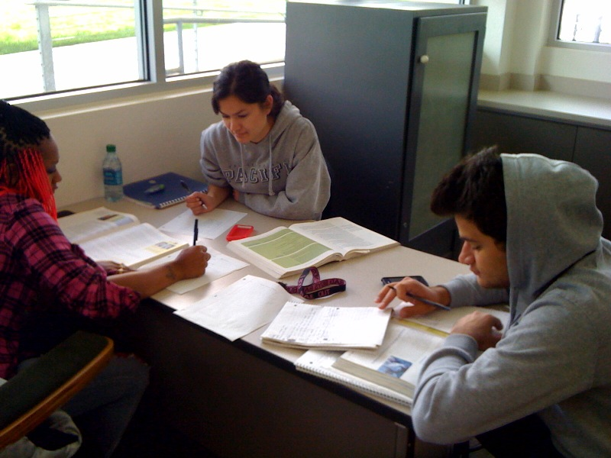

Slide 17
Student responsibilities:
Tutors (Psy 150 students)
  Three hours of training
  Meet weekly with tutees (12 hours total)
  Reflection journals
  Timesheets
Tutees (Psy 120 students)
  Meet weekly with tutors (12 hours total)
  Reflection journals
  Timesheets
Notes:
17

Slide 18
A growing program:
Notes:
18

Slide 19
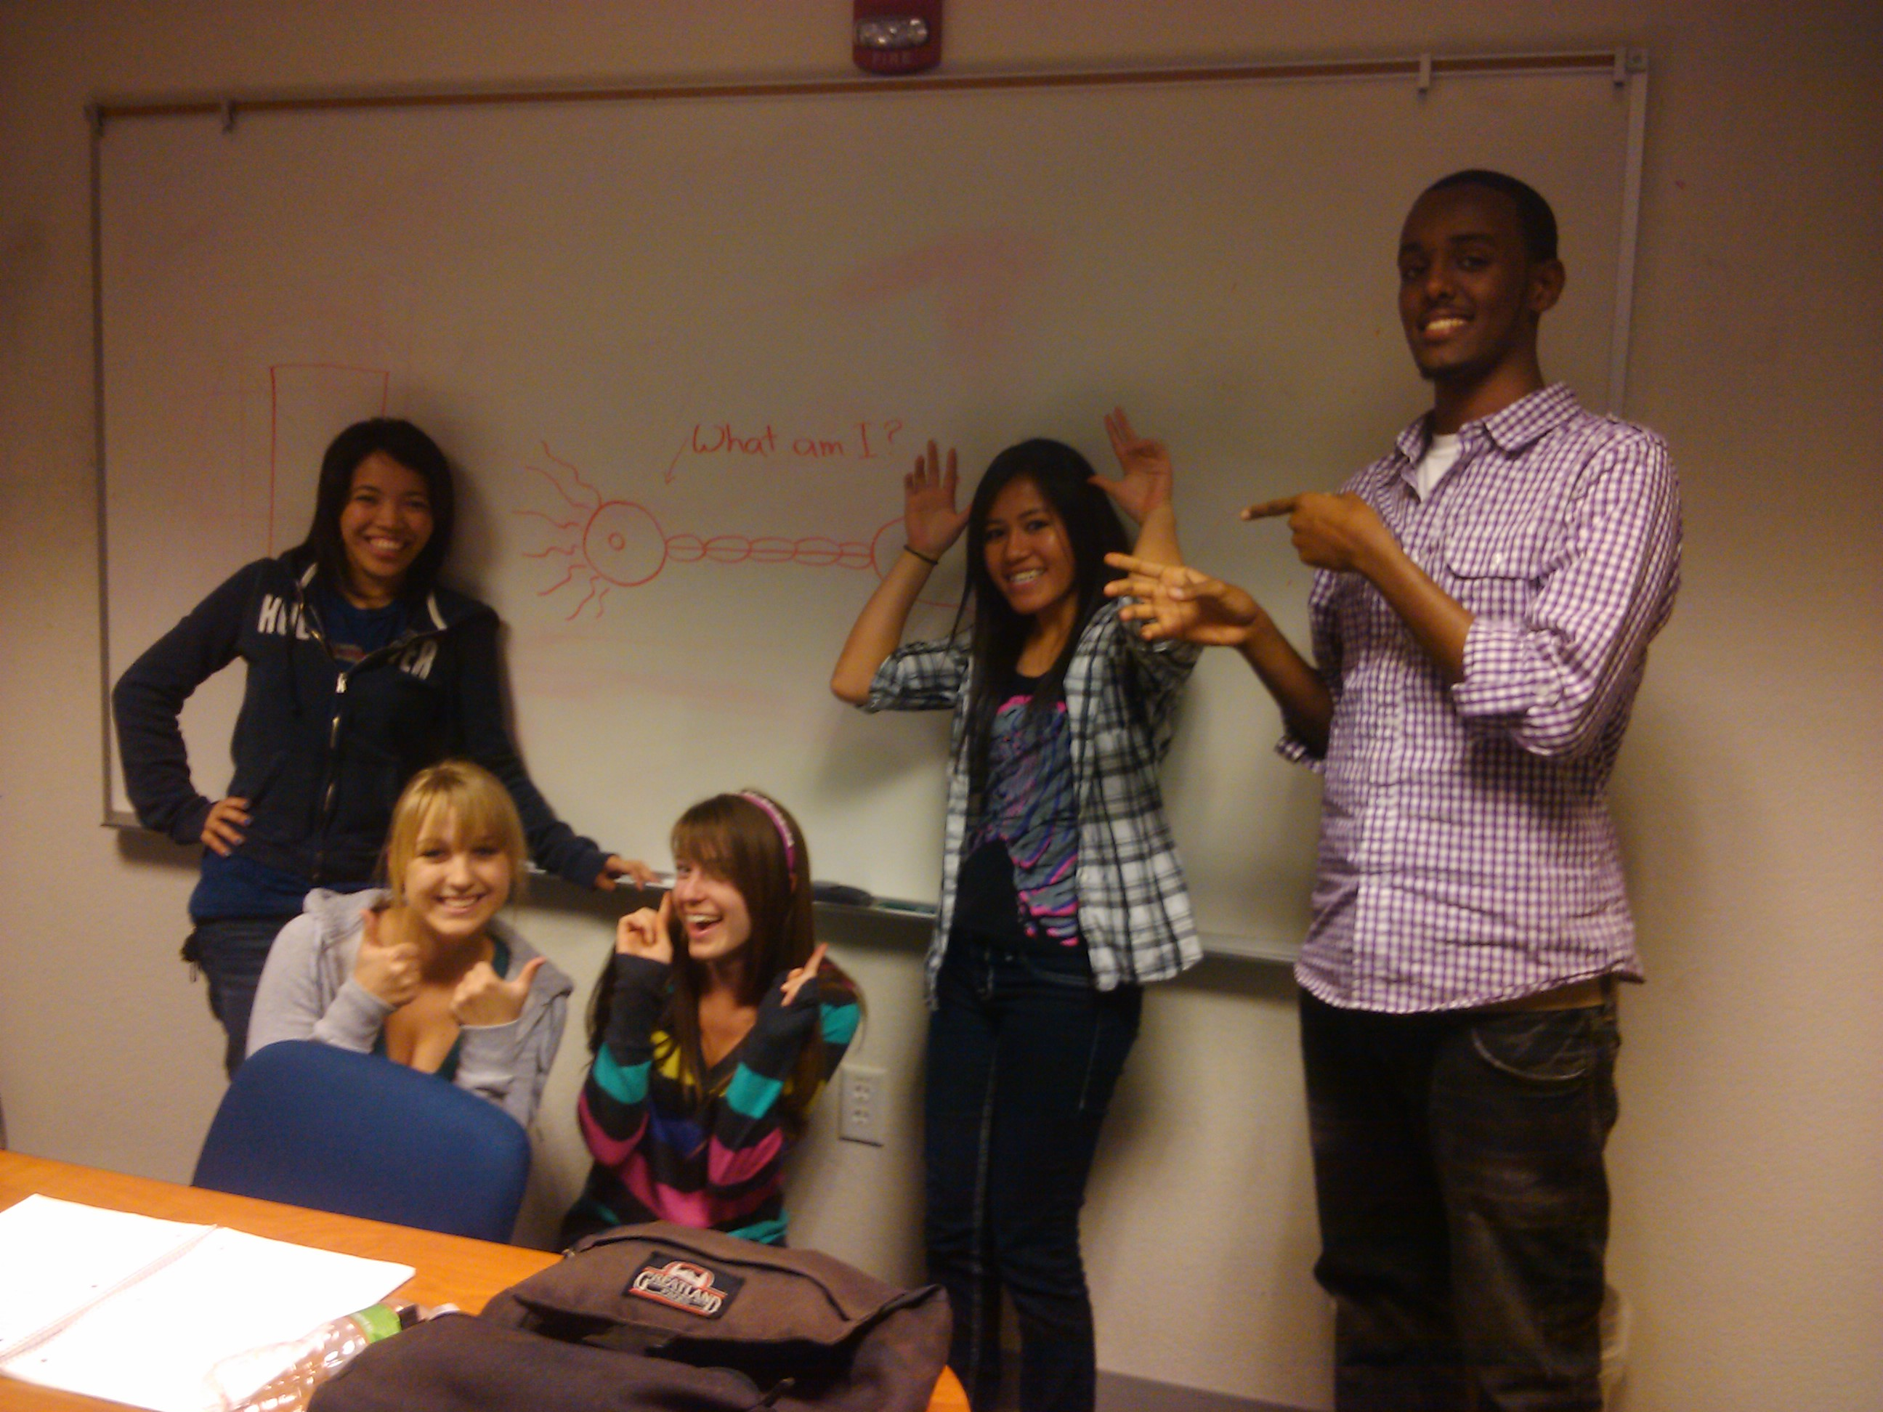

Slide 20
Sample Reflection Assignment for Tutees
What study technique did you learn? Do you think this technique will be useful to you? If so, explain how you plan to use it, if not, discuss why not, or describe a technique that you think will work better.
What Psychology concept(s) did you work on? Describe at least one of the concepts that you worked on in detail. (give a definition or example, outline key terms, etc.).
When you reviewed this material again, after your tutoring session, what question(s) did you have? Were you able to figure out the answer on your own?
Notes:
20

Slide 21


Slide 22
Sample Reflection Assignment for Tutors
What study techniques did you introduce to your student? (Include a brief description).
What Psychology concept did you work on? (Include a brief description).
Review your notes on Vygotsky’s sociocultural theory. Explain and give examples illustrating the relevance to your tutoring session of the following terms: zone of proximal development, scaffolding, guided participation. Discuss how your tutoring practices fit (or don’t fit) with Vygotsky’s model of cognitive development (internalizing an external routine in the context of social interaction).
Notes:
22

Slide 23
Who Passed?
“What were students’ success rates in PSY-120?”
Notes:
23

Slide 24
Who Passed?
“What were students’ success rates in all PSY-120 sections?”
Notes:
24

Slide 25
Did tutoring help?

Slide 26
Conclusions
CSL
…engages the student in learning outside the classroom.
…increases the relevance of academic work.
…encourages critical thinking.
…creates a community within a classroom and connects the college to the community.
…revitalizes the teacher and the student.
…instills a sense of serving others.

